Slide 1
Complex Applications
Disaster Recovery Environment- Assessment Overview
Author – Amit Kumar Reviewer – Narender Gusain

Slide 2
Agenda
Objective
Why BC/DR Critical
AstraZeneca DR Strategy Vision
Complex Applications: DR Maturity Assessment
Complex Applications: Documentation Adequacy Assessment
Current State and Desired state
Way Forward

Slide 3
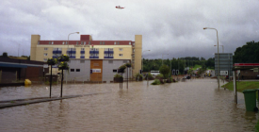
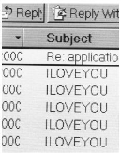



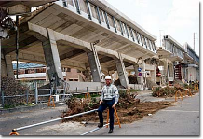



Objective
  Aim of the Disaster Recovery is to implement, maintain and execute appropriate countermeasures to guarantee the recovery of the IT Services for the In Scope Applications following a Disaster Declaration for an event affecting partially or totally one of the In Scope Data Centers, according to required RPO, RTO
A national research and consulting firm, conducted a survey of pharmaceutical and medical equipment manufacturers and discovered that many fail to follow proper procedures in the event of an emergency. According to the results, one major cause of this issue is the lack of proper training, as 60 percent of surveyed companies revealed that they conduct disaster recovery training exercises two or fewer times per year
*Best Practices, LLC*
Single Local Event
Wide Area Event
Logical Threat
Systemic Threat
Global Threat (Pandemic)
Fire
Hurricane
Avian Flue
Quake
Black out
Hacking
Flood
SARS
Viruses
Terrorism

Slide 4

The world is riskier than it used to be, requiring businesses to consider business resilience
Changing environment
  Expanding risk exposures
  Increased global and regional interdependencies
  Higher risks with complicated Supply Chains
Heightened impact of business disruption
  Greater financial implications of downtime
  Brand vulnerabilities
  Data integrity requirements
More complex regulations
  Changing industry and regulatory standards
  Geographic dispersal requirements
  Varying regulations per country

Slide 5
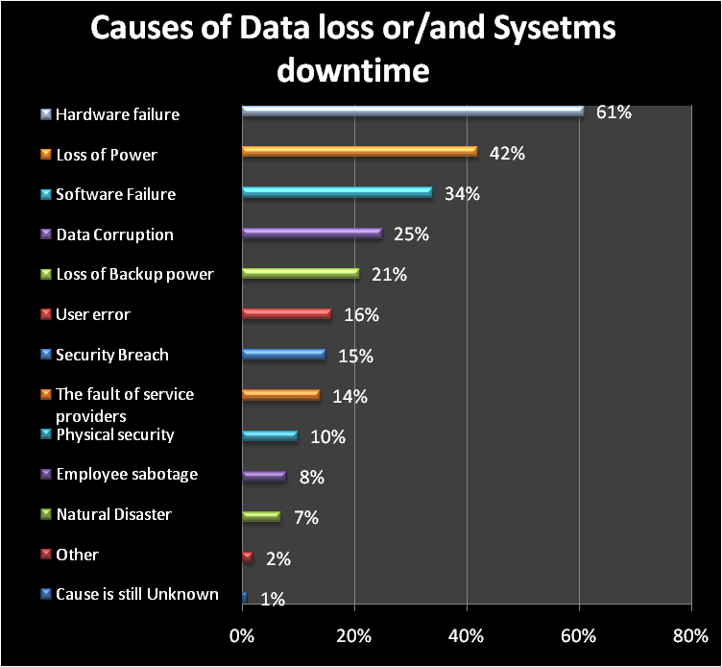
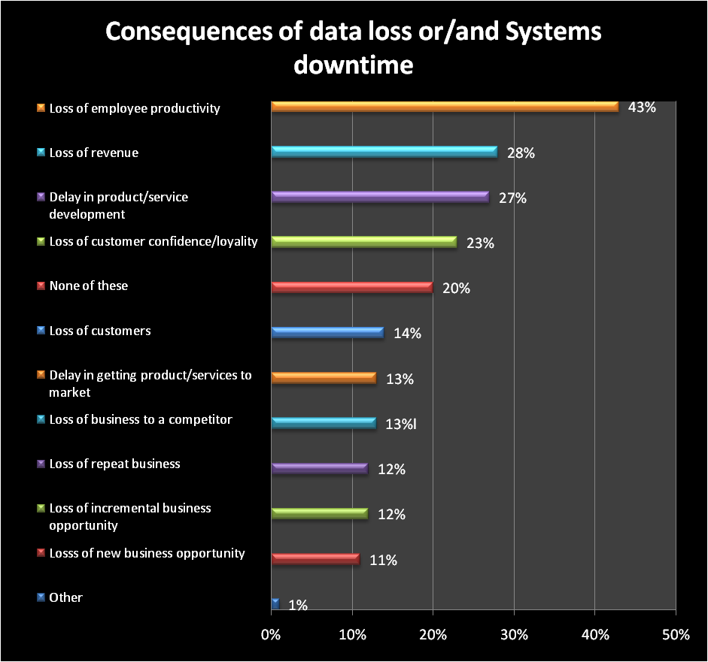
Impact of Disaster felt by Companies across Europe
Source: The Disaster Recovery Survey 2011: Europe-commissioned by EMC
(Surveyed 250 IT decision-makers in each of UK, France, Germany, Italy, Spain, Benelux and Russia across range of organizations)

Slide 6
AstraZeneca DR Strategy Vision
.
.
Business Objective
Applications/systems on the Critical Set list, together with supporting middleware / infrastructure, MUST have viable DR plans in place and will be subject to operational risk review by Global IS Security to ensure that risks are understood and visible.
As part of the DR strategy, a service recovery time should be established for each computerized system. A recovery point, at which the system can be considered to have been recovered, should also be defined. These should be based on business needs
Technology & Process
The DR plan should take into account the technical build of the system including interfacing or dependent systems, contacts for key individuals or suppliers, infrastructure used, network routing and physical location (including server ID and location).
Clear and documented processes at the site, system and computer centre levels, must be in place covering when a disaster is to be declared, by who and under what circumstances. This declaration will invoke the relevant BC and DR plans
Compliance & Audit
The on-going accuracy of the Critical Set list must be maintained by annual review.
Testing of both BC and DR plans is necessary to ensure that procedures are complete and workable and that staff are trained to respond to a disaster.
A test report should be produced containing learning from the test and actions to update the BC/DR plans as appropriate.

Slide 7
Complex Applications: DR Maturity Status
Key Considerations
Alignment with Business Requirements
Infrastructure Services Category
DR Exists
Recovery Point Objective
Recovery Time Objective
Technology
Storage Replication
Host based Replication
Tape Based Replication
Last DR Drill Report
Last DR Drill Status
Compliance & Audit
Maturity Status of Applications
Business requirements are defined and Solution is in place and is as per the business requirements
The application is tested and necessary actions are taken at regular intervals for DR capabilities
The applications can be recovered with additional efforts in the case of disaster
There is awareness of DR for these applications but no or little DR capabilities are in place
Little or no focus on DR for these applications
Leading
Mature
Capable
Aware
Average DR Assessment score 2.26
Adhoc

Slide 8
Complex Applications: Documentation Adequacy Status
Key Considerations
Business Objective
Infrastructure Details
Recovery Plans
Communication/R&R
DR Testing
RPO,RTO,DR Strategy, Alignment with BCP
Primary Hardware, DR Hardware
Application Overview, Interacting Applications, Recovery Procedures, Infra Recovery Plan
Recovery Team Contact details, Vendor details , R&R Incident Management, Disaster Declaration, Call Tree
DR Drill schedule, DR Test Scripts, Objective and Scope of Drill, Drill reports and status
Key Findings
75% application falls under either Critical or Key Focus applications classifications
7 Applications documentation has either no information or even lacks basic information
Only 6 applications documentation contain Good amount of Information
12 Applications documentation contain basic information from DR perspective
Documentation standardization is not there across the environment
Average DR Documentation Adequacy
score : 2.4

Slide 9
Gap Analysis
AZ DR Strategy
Findings
Impact
Business Objective
Technology & Process
Compliance & Audit
75% Complex applications falls under either Critical or Key Focus applications classifications
32% of Critical & Key focus applications RPO are not available either in documents or email
Lack of adequate information in documentation
58% of applications DR Drill is not carrying information as per Industry Best Practices
42% Critical/Key focus applications have either tape based recovery at cold site or not available
No information of Application group DR Drill Testing report
67% Critical application either have 24 Hours RTO or not defined
49% Critical & Key focus applications criticality category not documented or available
52% Complex applications criticality ratings are not available
Critical business function will not be available at the time of Disaster that impact
Greater financial implications of downtime
Brand vulnerabilities
Business Loss
Loss of trust with partners & Customers
If the DR solutions is not aligned with Business Objective Business function will not be available timely and expected fashion that’s leads to
Greater financial implications of downtime
Brand vulnerabilities
Data integrity requirements
Absence of inadequate DR Drill & process along with evidence will lead to
Non-Compliance of GXP & other regulatory requirements
Legal Issue & concerns as per specific country law
Not aligned with BCP/DR Standards like BS25999 & ISO22301

Slide 10
Current state and Desired state
CAPABLE : Some capabiltiy is established
but still reliability and meeting
business requirements is a concern
Mature: DR capability is tested
regularly and is reliable and continous improvements at organizational level
Current
Maturity
Level
Expected
Maturity
Level
0 1 2 3 4 5
Level Unfocussed | Level 2 Aware | Level 3 Capable | Level 4 Mature | Level 5 Optimal
DR capability are either not in place or are in nascent stage and not a consideration. No planned, documented and communicated process and procedures for recovery | There is some focus but not much has been implemented. Some basic capability is created but not reliable The process and procedure are not in place And does not meet business requirements. Success chances are low | Some capability has been developed but reliability and proof is still a bit of concern The process and procedures are in place to achieve intended and planned results as per Business requirements (wherever possible) There is some focus on development and implementation of best practices and conscious efforts have been taken in past Success is expected though inefficient in terms of cost and efforts | Efficient capability has been developed and costs estimation have been driven out on basis of execution cost and business impact Process and procedure are reviewed at regular intervals and are the most effective means of execution to deliver intended performance. The focus is on meeting business requirements in most effective way and continuous improvements as per dynamic environment Success with efficiency in terms of cost and efforts | DR capability is optimized. It is optimal as per the current business strategy and environment and keep adjusting itself Continuous efforts to optimize the capability and the value delivered to the business Business requirements focused service with operational excellence. Focus on following a holistic approach rather than only DR capability Success with maximum value contribution to the business

Slide 11
Future Course of Action/ Way Forward
Application Details & Business purpose
Understand Application Functions and Business units being supported by application
Identify criticality of Applications and deciding RPO & RTO
Support window and capacity being supported for application will be required
Access to application owners and Business units will be required
Application System Mapping
Understand the infrastructure requirements of Applications and identifying infrastructure to recover at the time of Disaster
Complete infrastructure details supporting each application will be required
Phase I: Initial information capturing phase
In this phase information will be gathered for in-scope applications to understand the business requirements of DR plan to formulate optimal solution satisfying requirements.
Also, information about the IT landscape will be gathered to provide input for next phase i.e. Formulating solutions
Application Dependencies
Understand the dependencies between different applications
Data flow information and Application architecture will be required
Backup Details
Understand the backup process
Backup schedules and Vaulting information will be required
Archiving Details
Understand Archiving process and compliance requirements
Other Infra system Details
Details about AD, DNS, Network, Security requirements will be required
Deployment Architecture
Required for formulating deployment of systems

Slide 12
Future Course of Action/ Way Forward Contd..
Phase II: Solution formulation & evaluation phase
1. Analysis of Information captured in Phase I
2. Formulation of various possible solutions
3. Evaluating different solutions
4. Identify and present optimal solution meeting business requirements
Phase III: Implementation and DR testing phase
Implementation of DR solution
Conducting DR drills as per business requirements
DR plan maintenance

Slide 13
Discussion

Slide 14
Annexure

Slide 15
0
5
Leading
4
Mature
3
Capable
2
Aware
1
Adhoc
0

Slide 16
0

